Slide 1

Visualizing the Solution Space of Educational Games using TRESTLE
Erik Harpstead
Human-Computer Interaction Institute
Carnegie Mellon University

Slide 2
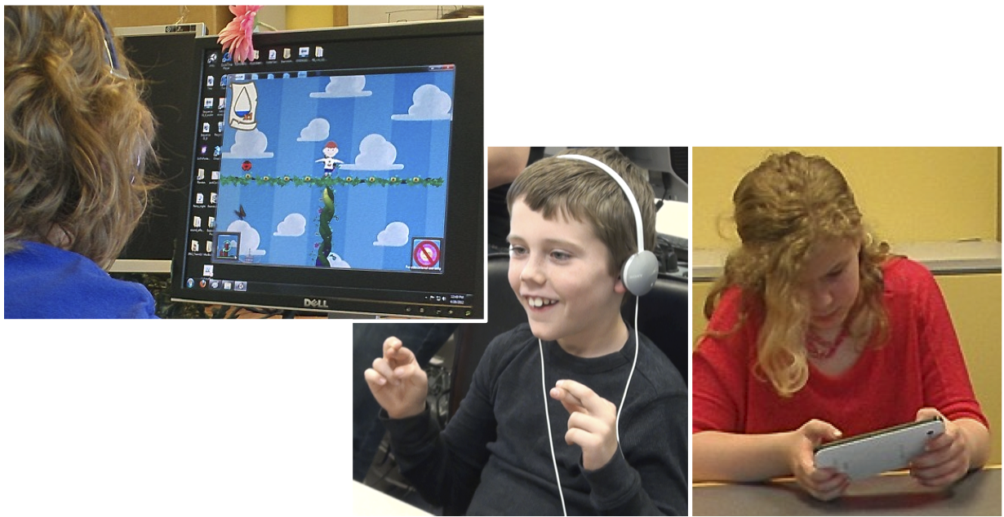
What does learner experience look like?
[Choi, et al., 2016]

Slide 3
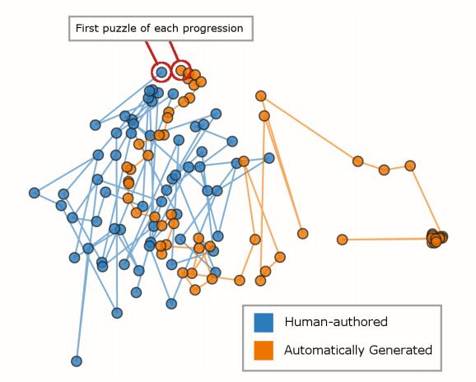
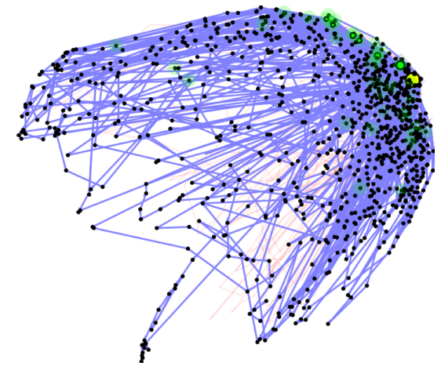
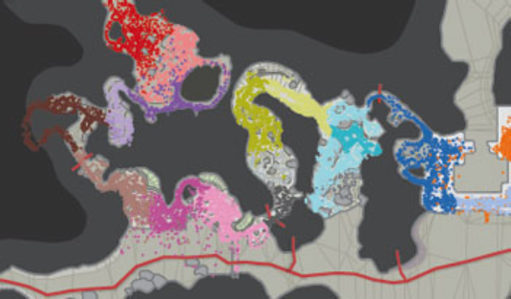
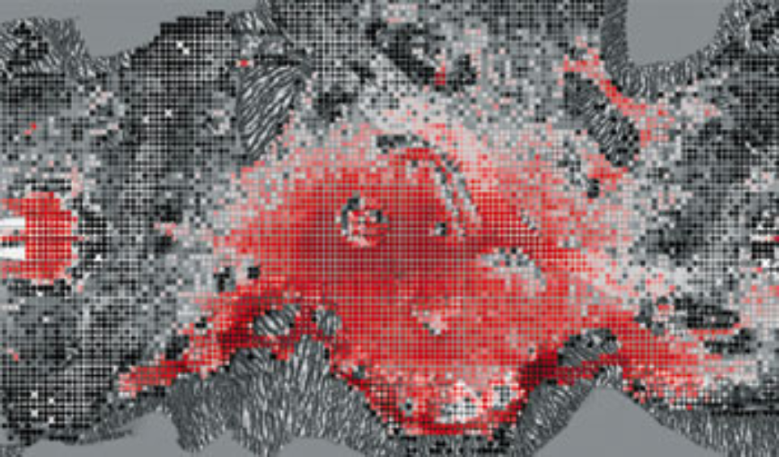
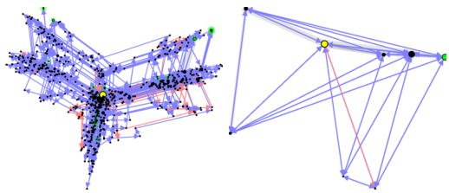
What does experience look like?
[Thompson, 2007; Andersen et al., 2010; Liu et al., 2011; Butler et al., 2015]
Notes:
Ref them

Slide 4
Seeing Solution Space
Solution space is a space of the functionally distinct ways to solve an in-game level or challenge
Allows designers to see how well calibrated their expectations for their experience are

Slide 5


An educational physics game developed in collaboration with Carnegie Mellon’s Entertainment Technology Center
Designed to teach basic concepts of balance and stability to K-3 (5-8-year-olds) children
3 main target principles:
An object with a wider base is more stable
An object with a lower center of mass is more stable
An object that is symmetrical is more stable
[Christel, et al., 2013]

Slide 6
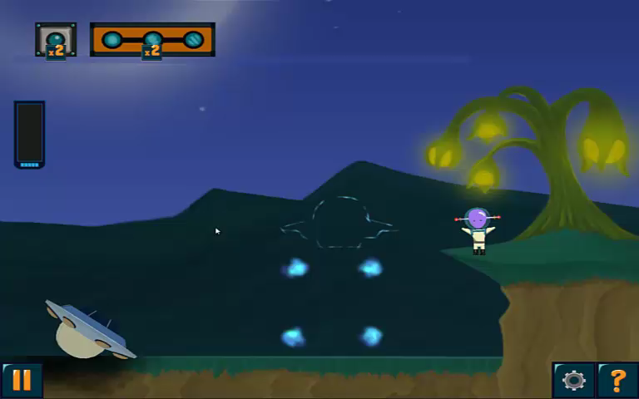

Slide 7
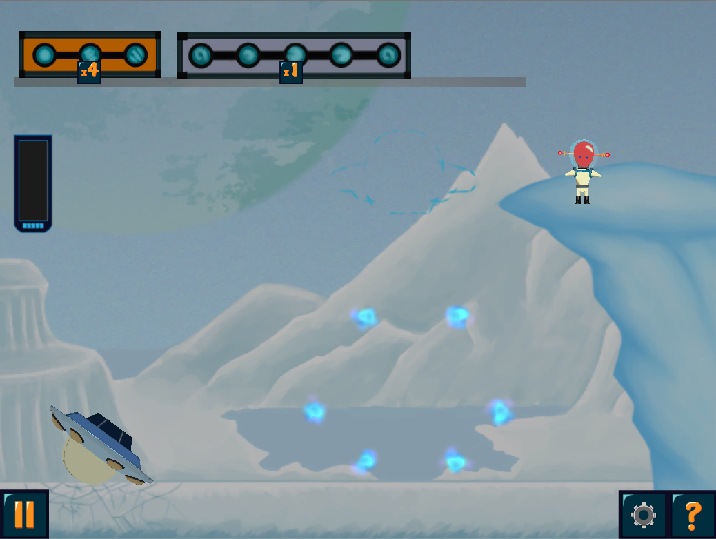
`
`
Notes:
Why is this important? How does understanding solution space help game designers?
Example of sitting down to design a level and what is it like?

Slide 8
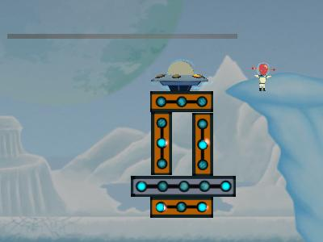
`
Notes:
Why is this important? How does understanding solution space help game designers?
Example of sitting down to design a level and what is it like?

Slide 9
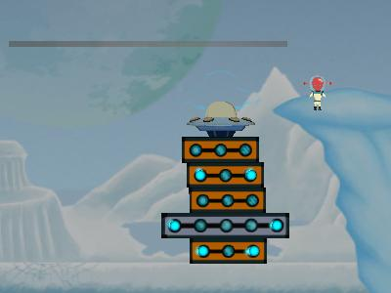
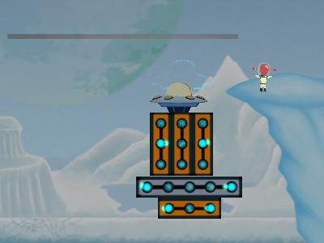
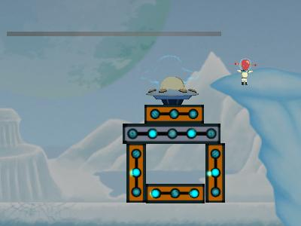
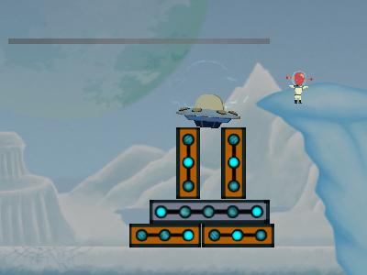
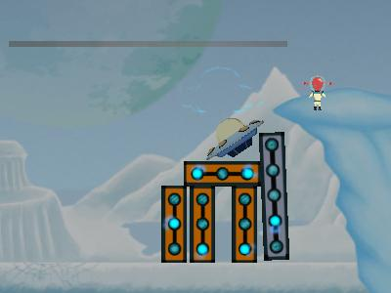
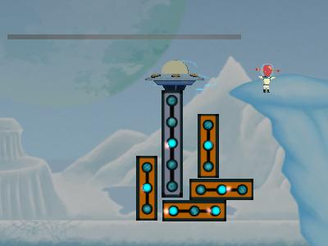
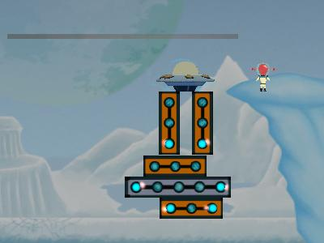
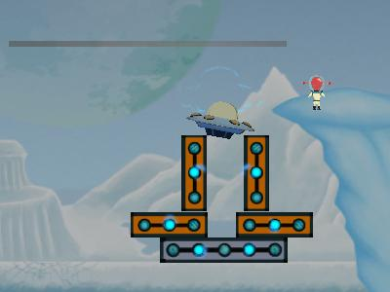
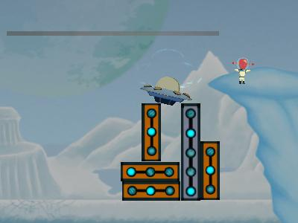
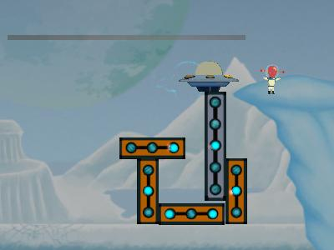
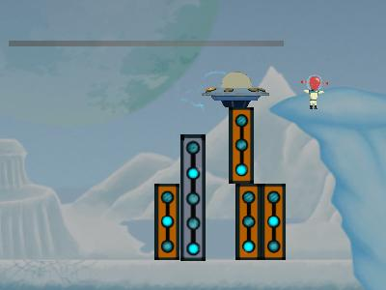
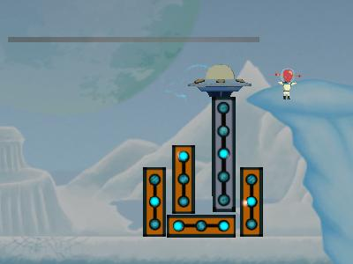
Notes:
How many ways are there to solve a given level?
Do we, as designers like all of them?
Why is this important? How does understanding solution space help game designers?
Example of sitting down to design a level and what is it like?

Slide 10
Clustering Player Solutions
Creating clusters of player solutions based on common properties or approaches to characterize solution space
Visualizing the clusters to designers for inspection of patterns

Slide 11
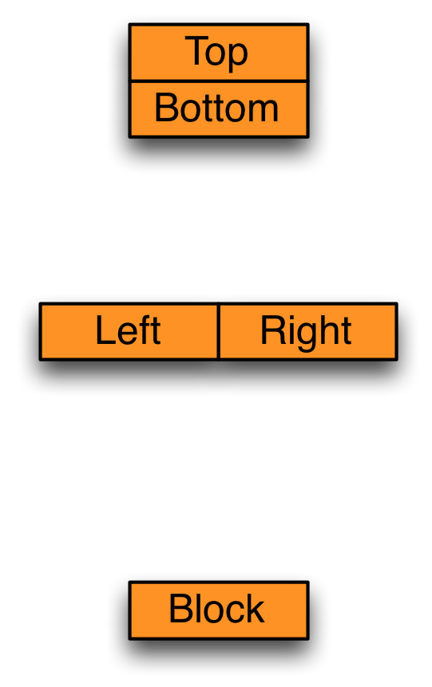
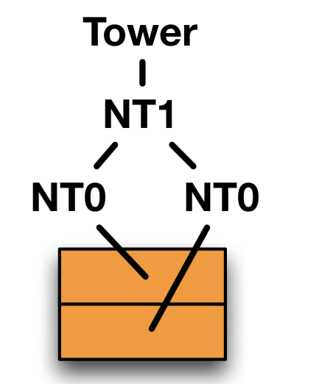
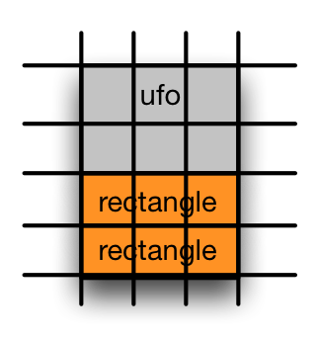
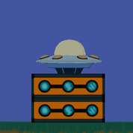
Conceptual Feature Extraction (CFE)
A grammar induction process for describing game states in terms of common structural features
Exhaustive Grammar Generation
Feature Generation
Discretization
Parsing
NT → BOTTOM TOP [vertical]
[1 0 0 1 1 … ]
NT → LEFT RIGHT [horizontal]
NT → block [unary]
[Harpstead, et al., 2013]
Notes:
Could bring up how this is applicable to many games and claim more about a contribution

Slide 12
Does CFE agree with humans?
Cluster CFE feature vectors using g-means clustering
Compare the results to groupings created by human assistants using Adjusted Rand index
Level | N | ARI Mean | ARI Std
Level 1 | 251 | 0.51 | 0.08
Level 2 | 249 | 0.47 | 0.04
Level 3 | 254 | 0.42 | 0.02

Slide 13
Percentage of player solutions that use the designer envisioned solution

Slide 14
Percentage of player solutions that use each unique solution type

Slide 15
Limitations of CFE
The process requires extensive feature engineering and deciding on what kinds of grammar rules to develop
The process is brittle and needs to relearn an entirely new grammar when new examples are added
Some structures cannot be described with a 2d context free grammar e.g.

Slide 16
The TRESTLE Algorithm
A concept formation algorithm that models the way that humans learn new concepts from structured examples
Designed to address the limitations of CFE by incrementally clustering states described by arbitrary JSON data
Builds a concept hierarchy by sorting instances and locally updating the hierarchy during sorting.
[MacLellan, Harpstead, Aleven, & Koedinger, 2016]

Slide 17
The TRESTLE Algorithm
At a high level the algorithm follows 3 major phases:
Partial matching
Flattening
Categorization

Slide 18
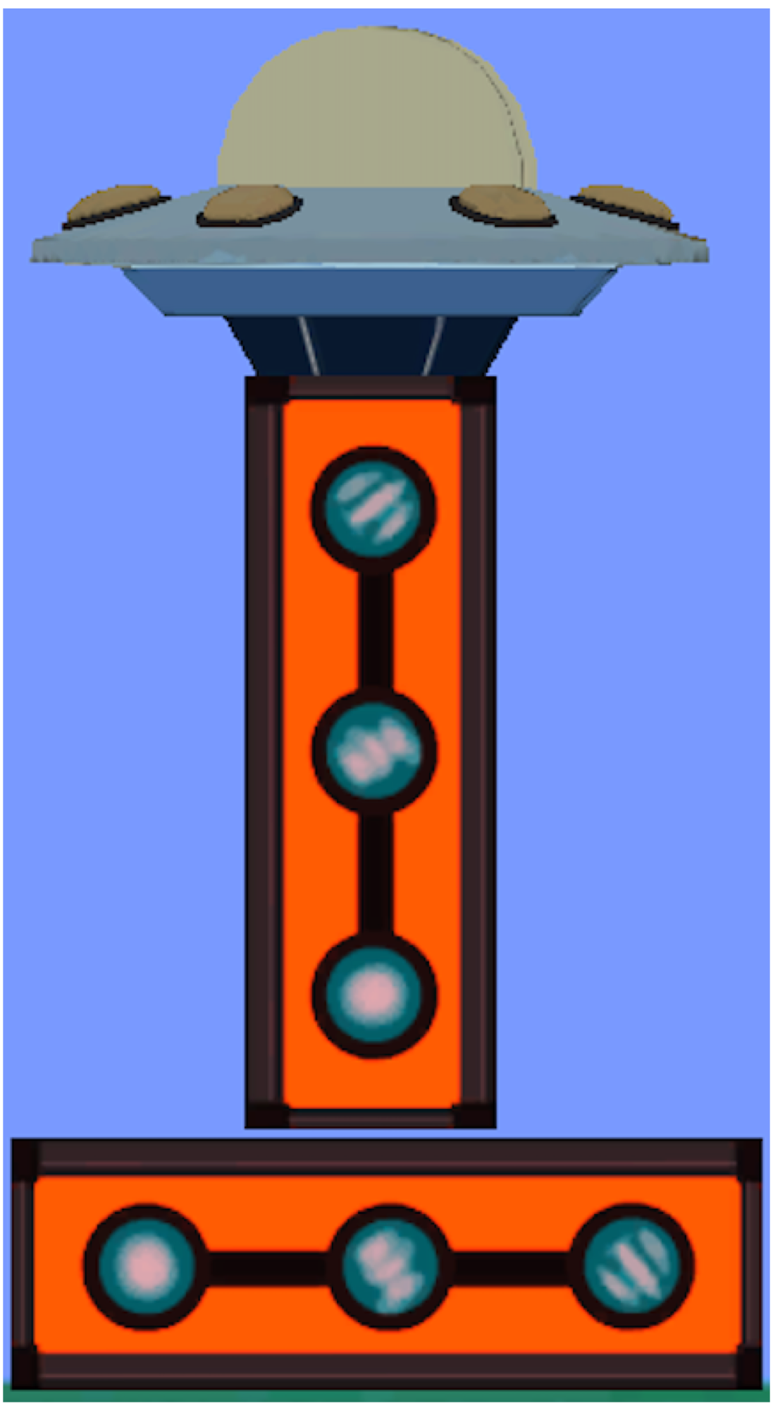
Instance Representation in TRESTLE
{ “_Success”: False,
“?Block1”: {“type”: “ufo”,
“angle”: 0.0,
“left”: 0.1,
“right”: 2.8,
“bottom”: 4.1,
“top”: 5.6},
“?Block2”:{ “type”: “rect”,
“angle”: 90.0,
“left”: 0.9,
“right”: 1.9,
“bottom”: 1.1,
“top”: 4.1},
“?Block3”:{ “type”: “rect”,
“angle”: 0.0,
“left”: 0.0,
“right”: 3.0,
“bottom”: 0.0,
“top”: 1.0},
“(On ?Block1 ?Block2)”: True,
“(On ?Block2 ?Block3)”: True}
Numerical
Nominal
Relational

Slide 19
Instance Representation in TRESTLE
{ “_Success”: False,
“?Block1”: {“type”: “ufo”,
“angle”: 0.0,
“left”: 0.1,
“right”: 2.8,
“bottom”: 4.1,
“top”: 5.6},
“?Block2”:{ “type”: “rect”,
“angle”: 90.0,
“left”: 0.9,
“right”: 1.9,
“bottom”: 1.1,
“top”: 4.1},
“?Block3”:{ “type”: “rect”,
“angle”: 0.0,
“left”: 0.0,
“right”: 3.0,
“bottom”: 0.0,
“top”: 1.0},
“(On ?Block1 ?Block2)”: True,
“(On ?Block2 ?Block3)”: True}
Numerical
Nominal
Relational

Slide 20
Partial Matching
Rename objects to maximize the expected number of correct guesses in the root concept:
{ “_Success”: False,
“?Block1”: {“type”: “ufo”,
“angle”: 0.0,
“left”: 0.1,
“right”: 2.8,
“bottom”: 4.1,
“top”: 5.6},
“?Block2”:{ “type”: “rect”,
“angle”: 90.0,
“left”: 0.9,
“right”: 1.9,
“bottom”: 1.1,
“top”: 4.1},
“?Block3”:{ “type”: “rect”,
“angle”: 0.0,
“left”: 0.0,
“right”: 3.0,
“bottom”: 0.0,
“top”: 1.0},
“(On ?Block1 ?Block2)”: True,
“(On ?Block2 ?Block3)”: True}
{ Successful: False,
c3: { type: “ufo”, … },
c2: { type: “rect”,
angle: 90.0,
…},
c1: { type: “rect”,
angle: 0.0,
…},
(On c3 c2): True,
(On c2 c1): True}
Use a best first search to efficiently compute the best match.

Slide 21
Flattening
Removes component attributes and add relational attributes that describe an equivalent structure
{ Successful: False,
c3: { type: “ufo”, … },
c2: { type: “rect”,
angle: 90.0,
…},
c1: { type: “rect”,
angle: 0.0,
…},
(On c3 c2): True,
(On c2 c1): True}
{ Successful: False,
(type c3): “ufo”,
…,
(type c2): “rect”,
(angle c2): 90.0,
…,
(type c1): “rect”,
(angle c2): 0.0,
…,
(On c3 c2): True,
(On c2 c1): True}

Slide 22
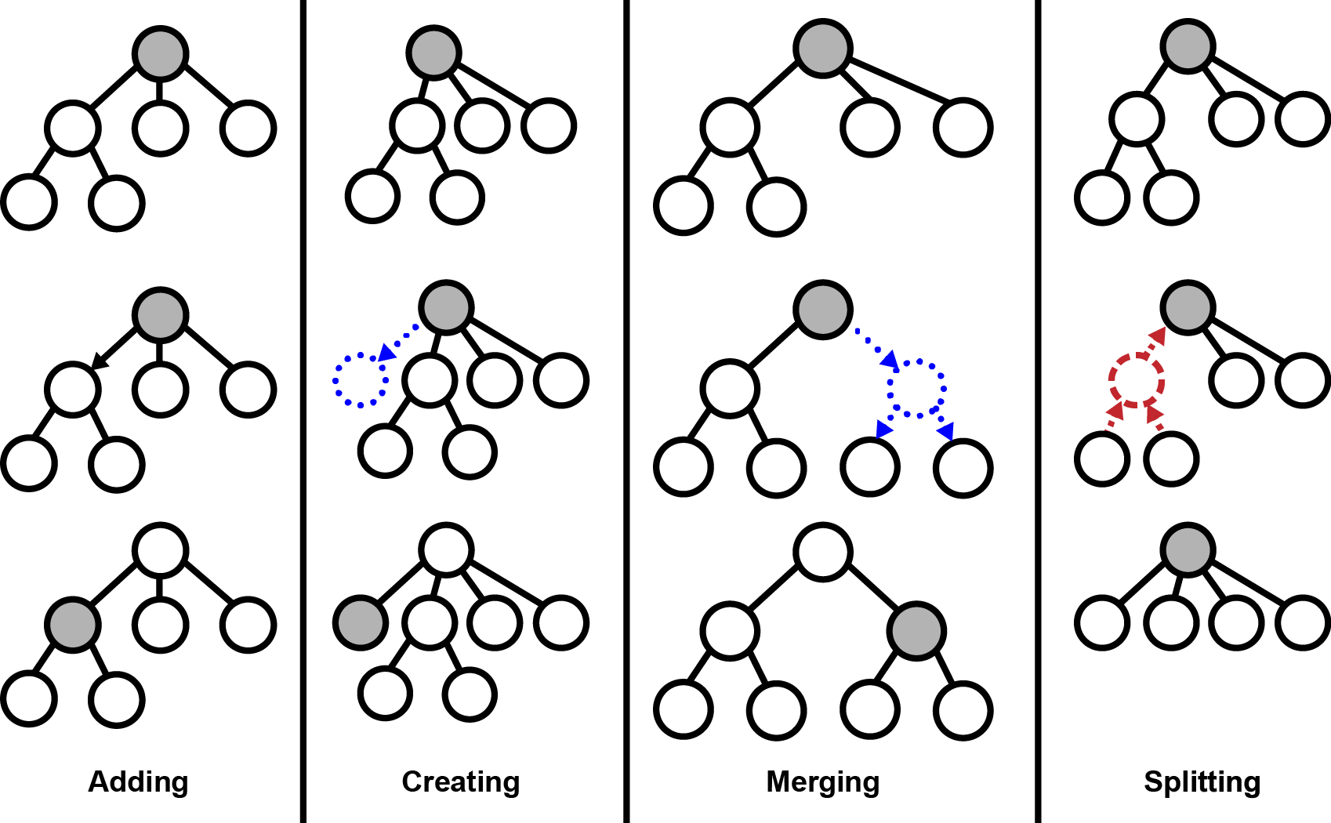
Categorization Operations

Slide 23
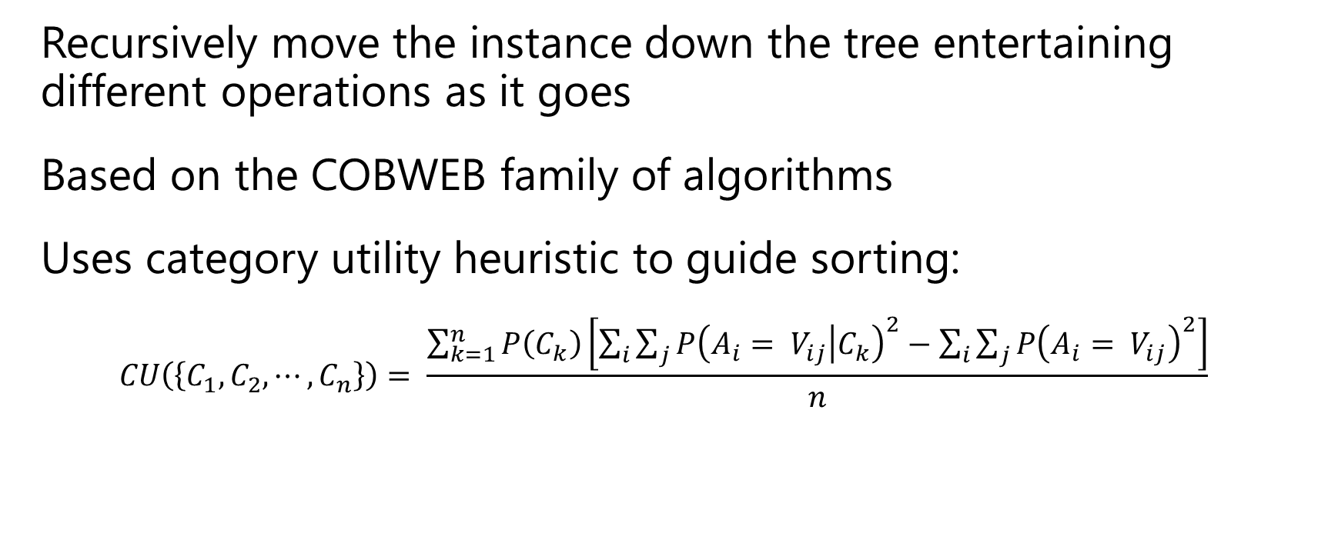
Categorization
Recursively move the instance down the tree entertaining different operations as it goes
Based on the COBWEB family of algorithms
Uses category utility heuristic to guide sorting:
$$CU\left(\left\{C_{1},C_{2},⋯,C_{n}\right\}\right)= \frac{\sum_{k=1}^{n}{P\left(C_{k}\right)\left[\sum_{i}{\sum_{j}{{P\left(A_{i}= V_{ij} | C_{k}\right)}^{2}}}−\sum_{i}{\sum_{j}{{P\left(A_{i}= V_{ij}\right)}^{2}}}\right]}}{n}$$
[Fisher, 1987]

Slide 24
Do these agree with humans?
Produce a flat clusters by iteratively splitting nodes in the tree optimizing for Akaike Information Criterion
Compare TRESTLE’s match to humans with CFE’s
 |  | TRESTLE |  | CFE
Level | N | ARI | STD | ARI | STD
Level 1 | 251 | 0.51 | 0.03 | 0.51 | 0.08
Level 2 | 249 | 0.57 | 0.05 | 0.47 | 0.04
Level 3 | 254 | 0.46 | 0.06 | 0.42 | 0.02

Slide 25
Live Demo?

Slide 26
Principle Relevant Metrics

Slide 27
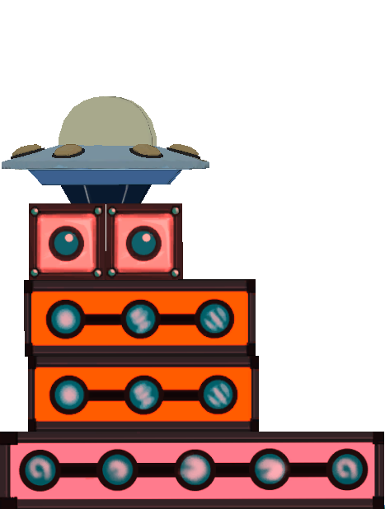
Principle-Relevant Metrics (PRMs)
Base Width
Center of Mass Height
Symmetry Angle
Notes:
Normalized per level to account for

Slide 28
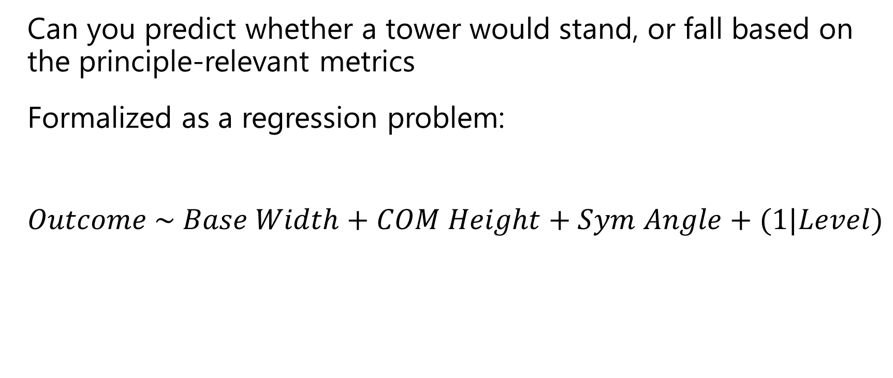
Alignment Regression
Can you predict whether a tower would stand, or fall based on the principle-relevant metrics
Formalized as a regression problem:
$$Outcome \sim Base Width+COM Height+Sym Angle+(1|Level)$$

Slide 29
Earthquake Math

Slide 30
First start with the Earthquake
$T$ = duration of the earthquake
$n$ = number of cycles of the earthquake
$D$ = amplitude of the earthquake’s motion
$f$ = $\frac{n}{T}$
$ω$ = $2πf$
$A$ = maximum acceleration = $ω^{2}D$
$α$ = proportion of $g$ = $\frac{A}{g}$
Essentially how many g’s of acceleration does the earthquake impart on the tower

Slide 31
Now the Tower
$h$ = height of the center of mass
$d$ = horizontal distance of the center of mass from the nearest edge of the base
$W$ = weight of the tower = $mg$
Threshold of motion, i.e. the minimum force required to move the tower is if
$αW>W\frac{d}{h}$ or $α>\frac{d}{h}$
The energy required to cause the tower to topple is:
$$E_{r}=W (\sqrt{h^{2}+d^{2}}−h)$$
d
h

Slide 32
The Energy Imparted on the Tower
The energy imparted on the tower is the force imparted multiplied by the total tower. The force imparted is ideally $αW$ and the total distance would be $n4D$. Making the total energy imparted on the total:
$$E_{i}=αW∗n4D$$
However, its not that simple. Since the quake is oscillating it is not imparting force perfectly on the tower and not all the motion is contributing to the tower falling, such as when the tower jumps briefly or when the motion is switching direction. To account for this you multiply by scaling factors but you can really only determine those scaling factors empirically. Making the real equation:
$$E_{i}=XαW∗Yn4D$$
where $X$ and $Y$ are some scaling factor between 0 and 1. In our discussion he threw out $X$ = .25 and $Y$ = .10 as possible examples.

Slide 33
The Final Formula
Basically this is saying the tower falls when $E_{i}>E_{r}$ or:
$$XαW∗Yn4D>W (\sqrt{h^{2}+d^{2}}−h)$$
Note that there is a W in both sides of the equation that can be factored out making the final formula:
$$Xα∗Yn4D>(\sqrt{h^{2}+d^{2}}−h)$$
This means that the weight won’t matter in terms of knocking a tower over with an earthquake. He supported this conclusion and did mention that the weight would matter if it we were talking about a projectile impact.
Since everything on the left side is either based on the earthquake or a constant we can’t calculate all we really need is the value on the right to compare the stability of towers in an earthquake. So whichever one has a greater $E_{r}$ is “more stable.”

